Slide 1
Hip joint
Synovial joint of ball and socket variety. Produces same movement as shoulder joint but range restricted hence sacrificed mobility for stability.
Articulating bones: Head of femur with acetabular cavity of hip bone.
Acetabular presents a horse-shoe shaped, lunate articular surface, acetabular fossa.
The lunate surface is covered with cartilage and the notch converted into a foramen by transverse acetabular ligament.
Edge of the acetabulum and transverse acetabular ligament provides attachment to the labrum acetabulare.

Slide 2
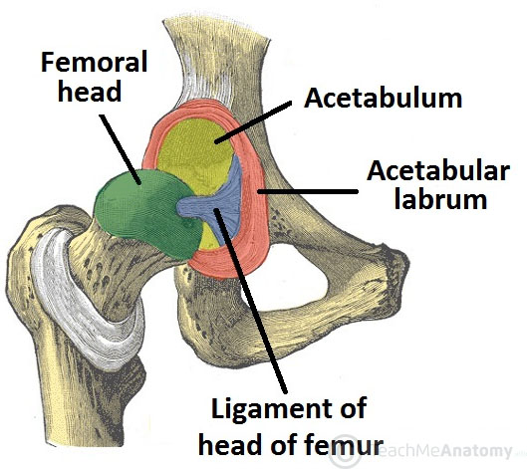
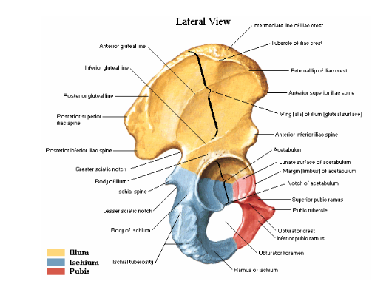

Slide 3
The labrum acetabulare is triangular in shape which function to deepen the cavity, maintain bony contact and to protect the edge of acetabulum.
Head of femur: It is spherical and covered with articular cavity all over except in the region of small pit which lies a little below and behind the centre of the head called fovea capitis femoris. It gives attachment to ligamentum teres femoris.
The articular surface of the head extend a little in front of femoral neck.
Capsule: Attaches at the periphery of acetabulum beyond labrum acetabule and also to transverse acetabular lig.
At the femur, it is attached along inter-trachanteric line anteriorly.

Slide 4
Posteriorly is attached at the middle of the neck of femur short of inter-trochanteric crest.
Neck of femur completely intracapsular anteriorly while partially intracapsular posteriorly.
Hip capsule stronger than shoulder capsule.
Anteriorly capsule thick and firmly attached to bone, subject to maximum tension in standing.
Posterior thin and loosely attached to bone.
The capsule fibres are arranged in two sets; outer longitudinal superficial best developed anterior superior and inner circular deep (zona orbicularis).

Slide 5
Ligaments: Capsular ligament include, ilio-femoral, ischio-femoral,
pubo-femoral (thickened fibrous capsule band), ligamentum teres femoris, transverse acetabular lig., labrum acetabular and retinacular ligament.

Slide 6
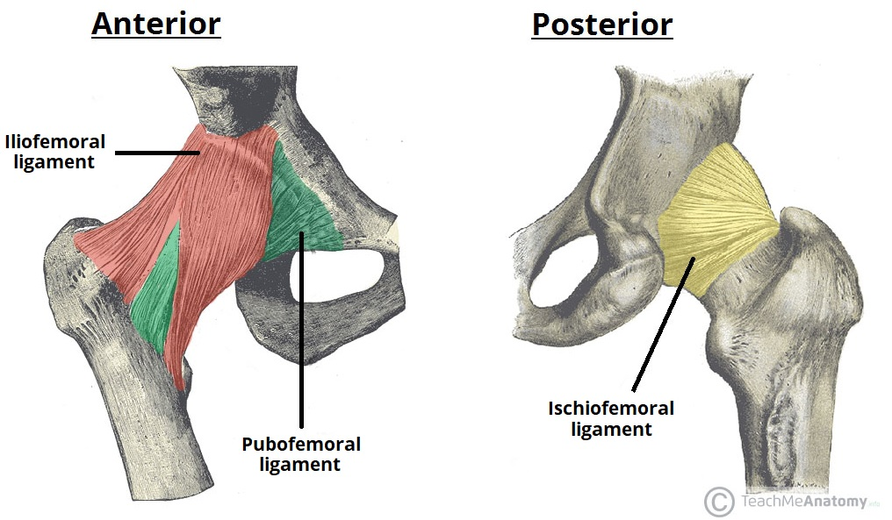
Iliofemoral lig.; Located in front of hip joint and is one of the strongest lig. In the body known as lig. of Bigelow. It is an inverted Y-shaped. Apex of it is attached at lower part of anterior inferior iliac spine below straight head of rectus femoris. The two limbs are attached at upper and lower trochanteric line. It is medially inverted and laterally oblique.
Function: Add strength to capsule; prevent excessive extension; during standing help balance pelvis over head of femur; lat. help the limb prevent excessive adduction.

Slide 7
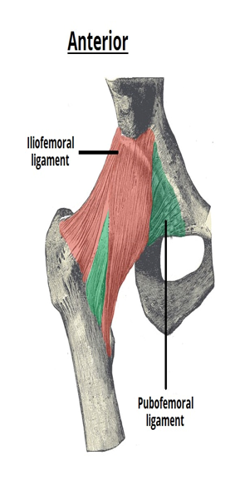
Pubo-femoral ligament: Runs between pubis and anterior inferior part of hip joint capsule. Many times psoas bursa communicates with joint cavity through a gap between pubo-femoral lig. and iliofemoral lig.
Function: Prevents excessive abduction.

Slide 8
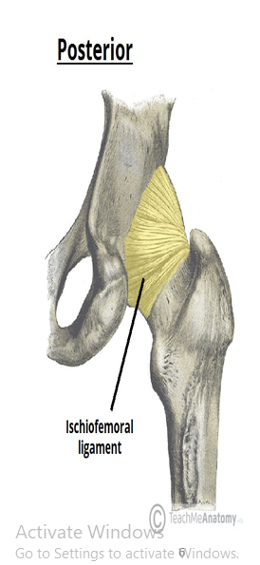
Ischio-femoral ligament: It runs from ischium to the posterior of hip joint capsule.
Function: Prevent excessive medial rotation.

Slide 9
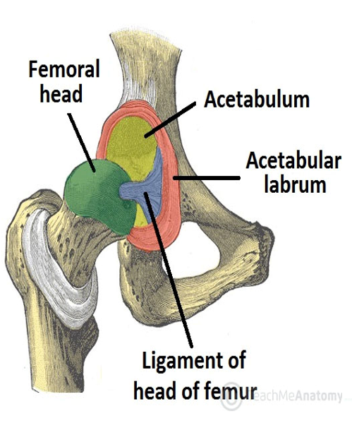
Ligament of head of femur: Attaches to the pit in the head of femur and the transverse acetabular ligament. limiting the acetabular notch.
Broad at the acetabular attachment and narrow at the insertion at femur.
Function: Carries blood to head of femur from acetabular.
Transverse ligament: Attaches to the margins of acetabular notch converting it into a foramen. It is supplied by acetabular artery from obturator artery.

Slide 10
Synovial membrane: Covers the capsule of hip joint inside and non articular area of the femoral neck except articular area of the head with separate synovial memb.
Innervation: Accessory obturator N. if present; Sciatic N; Nerve to rectus femoris; Nerve to quadratus femoris & obturator N.
Arterial supply: Superior and inferior gluteal arteries, medial and lateral circumflex femoral arteries & obturator artery.

Slide 11
Applied Anatomy: (i) Posterior dislocation of the joint is common and may or may not be associated with acetabular rim.
(ii) Fracture of neck of femur occurs in old age due to osteoporosis.
(iii) Coxa Vulgaris; increase in the neck shaft angle and commonly seen in congenital dislocation of hip.
(iv) Perth’s disease, destruction and flattening of the head of femur, usually in children below 5yrs.
(v) Coxa vara; Normal neck shaft is 125° in adult and in children 150°. In this condition it decreases which limits movement of abduction seen in fractured neck.
(vi) Irritable hip; due to inflammation of synovial memb. Seen in children.

Slide 12
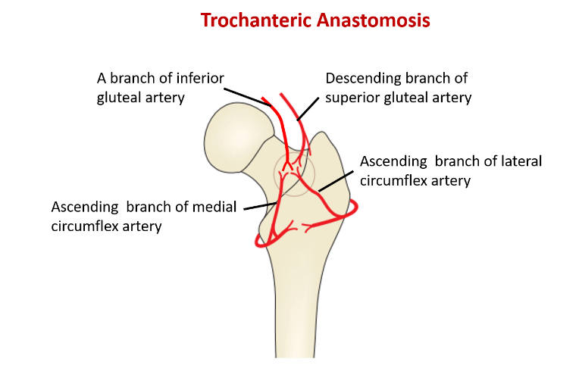
Anastomosis around the hip joint: It includes trochanteric anastomosis and cruciate anastomosis.
Trochanteric anastomosis: Situated near trochanteric fossa. The ascending branch of lateral femoral circumflex artery anastomosis with ascending branch of medial femoral circumflex artery with the deep branch of superior gluteal artery. They supply the head of femur.

Slide 13
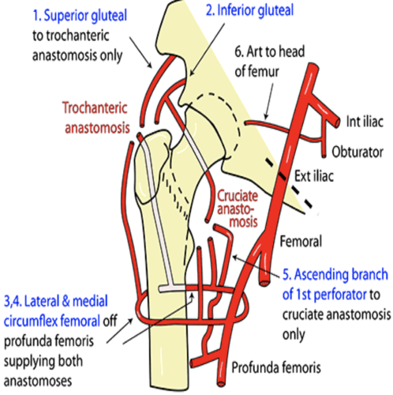
Cruciate anastomosis: Situated upper back of thigh at level of lesser trochanter just below the attachment of quadratus femoris. The transverse branch of lateral femoral circumflex artery anastomosis with transverse branch of medial femoral circumflex artery. The 1st perforating branch of profunda femoris anastomosing with a branch from inferior gluteal artery.
Its function is to provide an alternative supply to lower limb if there is blockage of blood b/w external iliac & femoral arteries.

Slide 14
